Slide 1
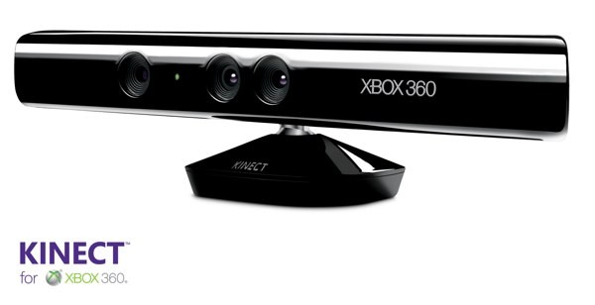
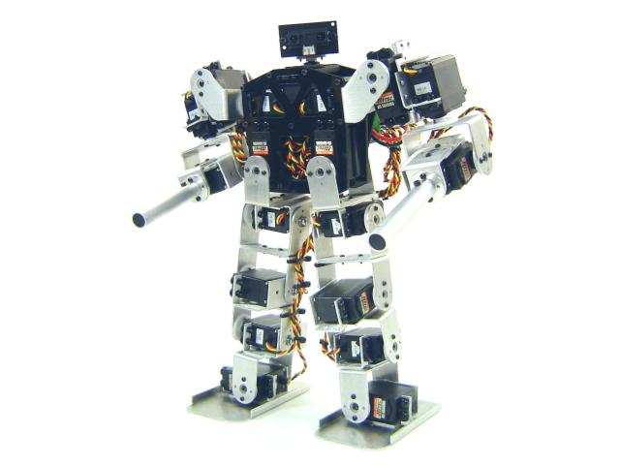
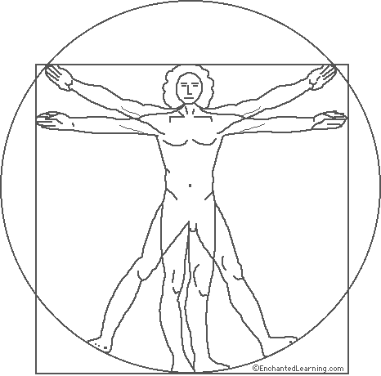
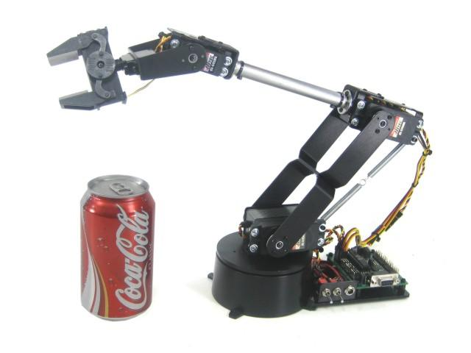
Robotic Natural User Interface RoboNui
What is RoboNui?
A control system interface for a robotic manipulator
Uses the natural motion of the human body to control the robot.
Business Case
Investigate and the capabilities of the Kinect for product use.
Demonstrate the more relevant capabilities as RoboNui.
GUI
Record/Playback
Applications
Robotic Control
Robotic-Human Interaction
Evacuation, Bomb-removal, Scout Robots
Natural User Interfaces
i.e. Minority Report
Core Business Logic
Kinect Adapter
Robotics Adapter

